Slide 1
Dataset
  Chest X-ray images :
    Training set- {covid: 460,normal: 1266 , pneumonia: 3418 }
    Test set – {covid: 116,normal: 317, pneumonia: 855}

Slide 2
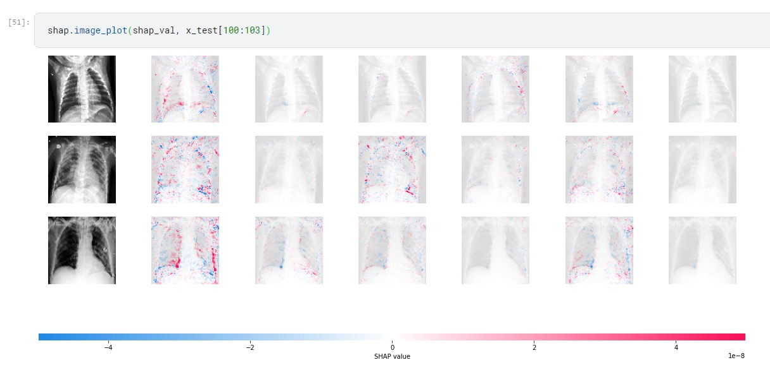
Shap values –try out on RestNet50 model prediction
Need to fine tune results**

Slide 3
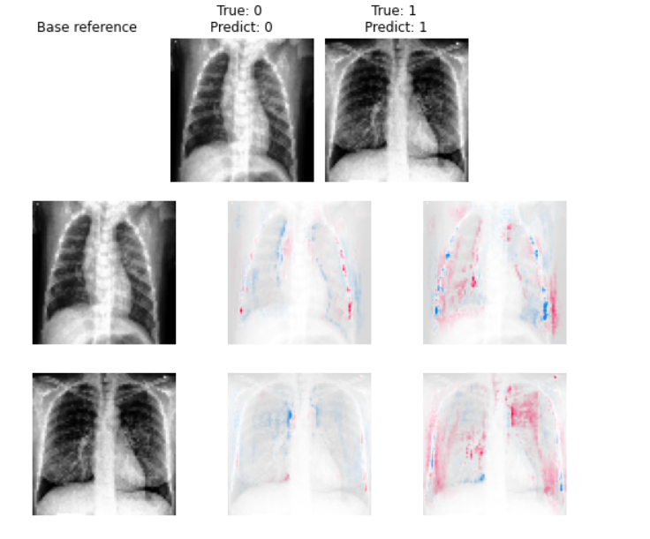
Shap for CNN without resampling
Red - positive influence on classification
Blue – negative influence on classification
Non covid
covid

Slide 4
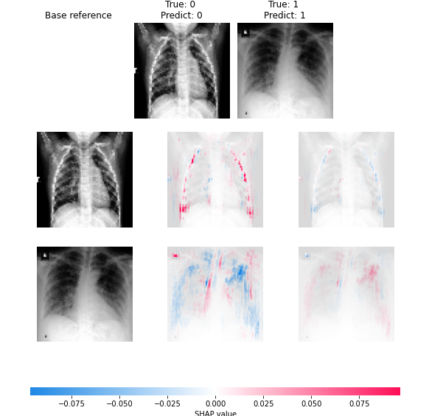
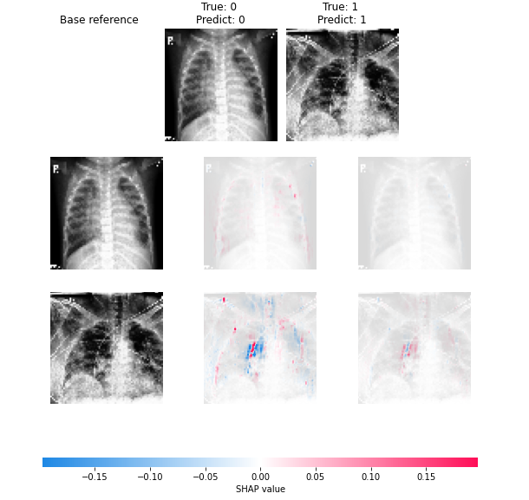
Shap for CNN with resampling
oversampling
undersampling

Slide 5
Progress
CNN, ResNet50 without resampling – done
CNN, ResNet50 with resampling(oversampling and under sampling) – done
VGG-16 – (resolving a problem in model fitting)
Shapley values on models – CNN(done), ResNet50(done), VGG-16 (in progress)

Slide 6
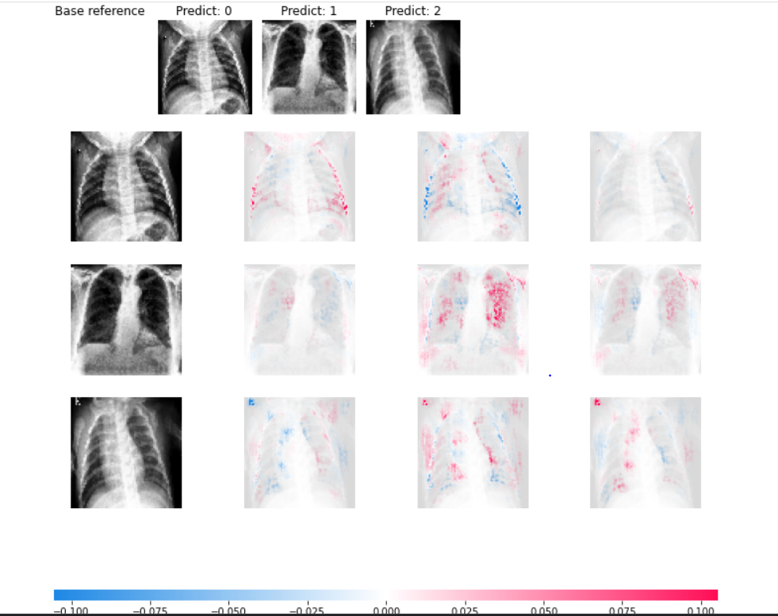
Notes:
Red pixels represent positive SHAP values that contributed to classifying that image as that particular class.
Blue pixels represent negative SHAP values that contributed to not classifying that image as that particular class.

